Slide 1
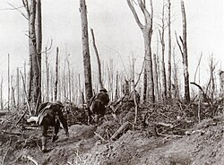
Battle Analysis: Meuse–Argonne Offensive 26 Sep 1918 – 11 Nov 1918
As of: 10 FEB 2026
POC: CDT Bolton, Davis
By, CDT Davis and CDT Bolton
18 FEB 2026

Slide 2
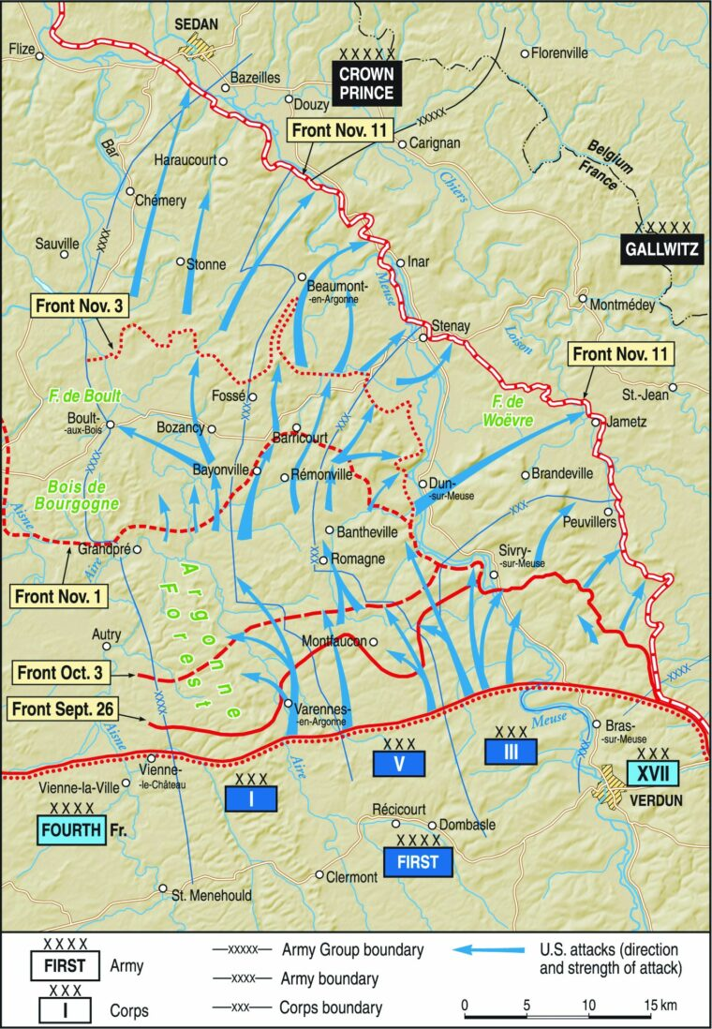
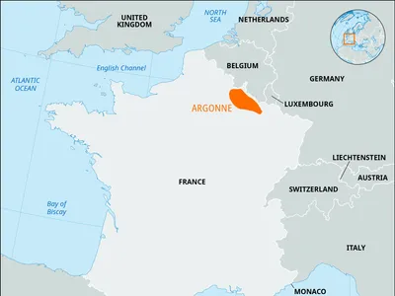
DEFINE
Who:
American Expedition Forces (AEF) verses German Fifth Army
What:
Largest U.S. offensive of World War 1
When:
26 Sep 1918 – 11 Nov 1918 (47 Days)
Where:
Meuse River- Argonne Forest
Why:
Break German defensive line, cut Sedan rail hub

Slide 3
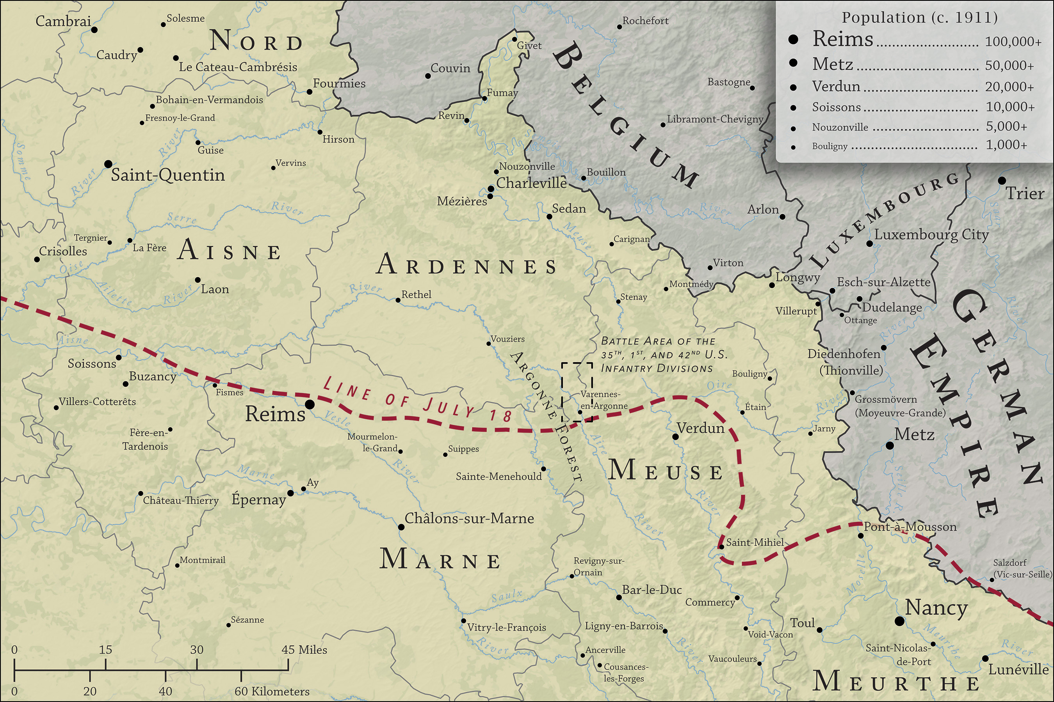
Strategic Context
Strategic / Operational Overview
War: World War I (1914–1918)
Timeframe & Location: Western Front, France, late 1918
War Aims
Allies: Break German defensive lines, force German surrender before winter.
Germany: Hold defensive positions long enough to negotiate favorable armistice terms.
Campaign Context
Part of the Allied Hundred Days Offensive.
Coordinated with French attacks to the east and British attacks to the north.
Objective: penetrate the Hindenburg Line and cut the German rail network at Sedan.

Slide 4
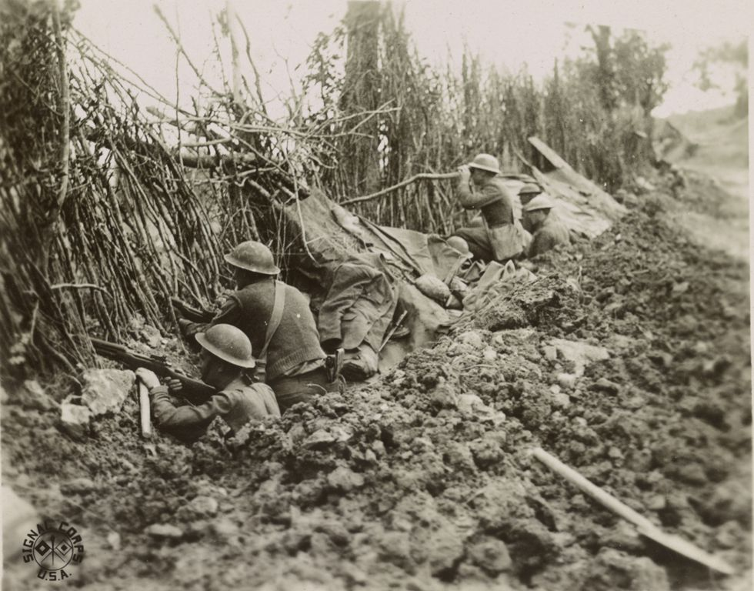
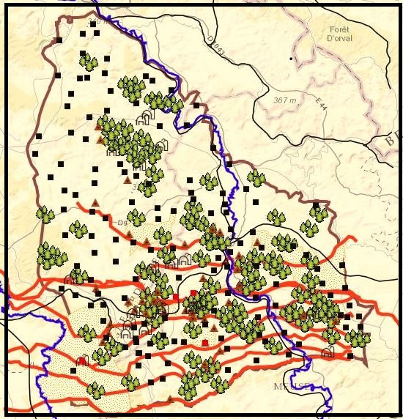
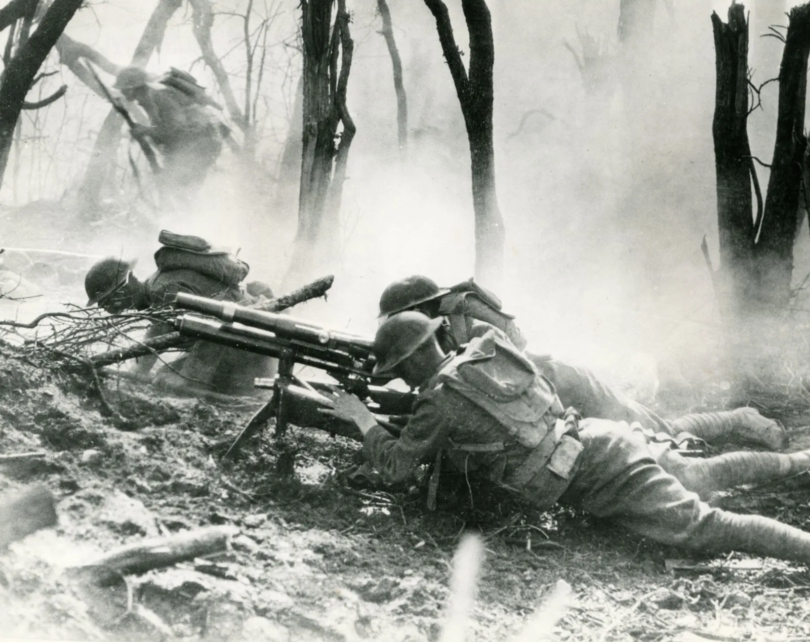
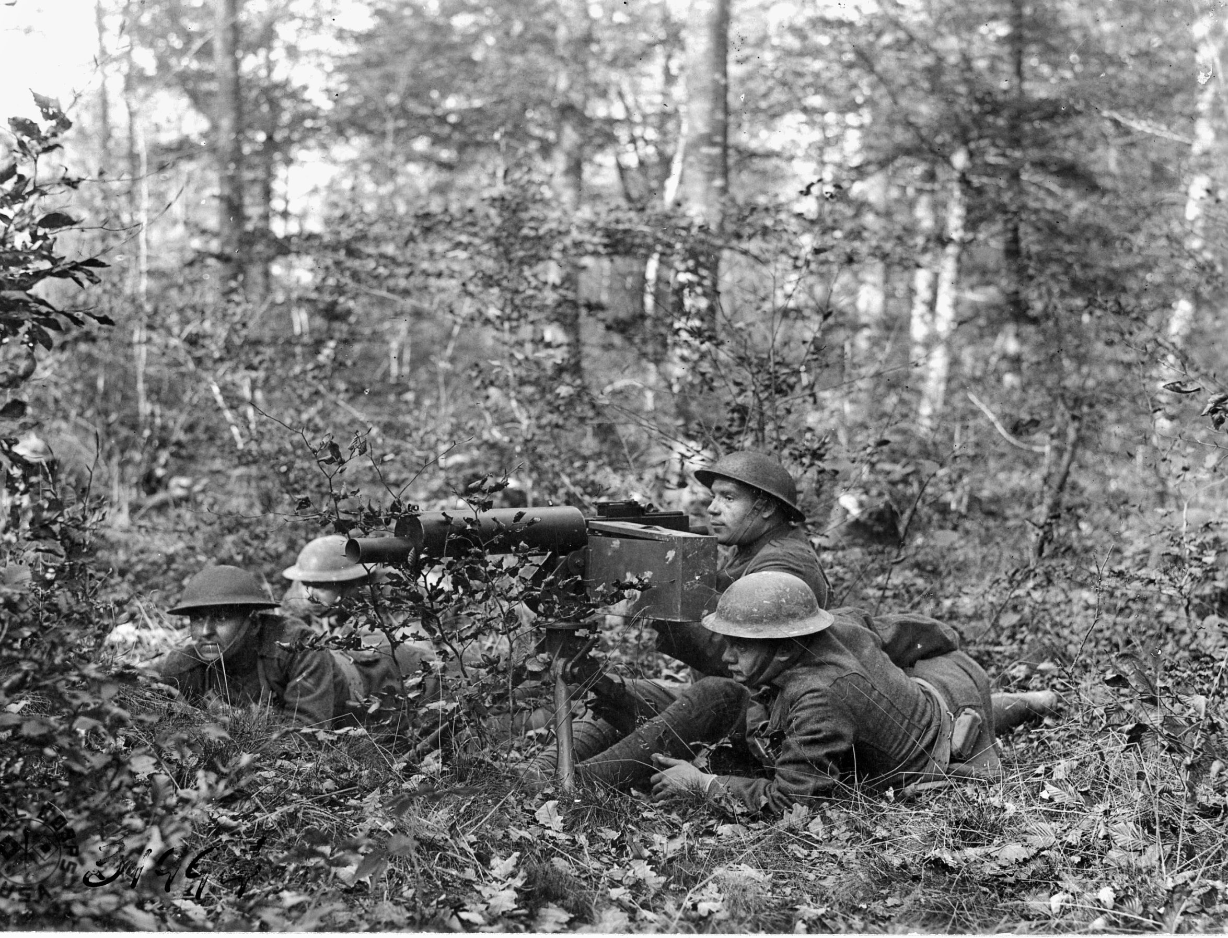
Operational Environment
Area of Operations
Weather
Frequent rain, fog, and cold.
Mud slowed movement, resupply, and artillery positioning.
Terrain (OAKOC)
Observation & Fields of Fire: Limited by dense forest and rough terrain.
Avenues of Approach: Narrow valleys and roads channeled movement.
Key Terrain:
Heights east of the Argonne
Meuse River crossings
Rail hub at Sedan
Obstacles:
Thick forest
Ravines
Barbed wire and fortified German positions
Cover & Concealment: Forest provided concealment but reduced coordination and control.
Terrain Advantage: Favored the defenders (Germany).

Slide 5
Combat Power Comparison
AEF | German 5th Army
Large, inexperienced | Veterans, exhausted
Offensive Doctrine | Defensive-in-depth
Logistical learning curve | Internal rail advantage
High Morale | Declining Moral

Slide 6
Mission, Intent, and Initial Disposition
American Expedition Forces (AEF) Mission:
U.S First Army tasked to:
Penetrate successive German defensive belts
Seize key terrain northward
Ultimately cut the Sedan rail hub
This was not just a “seize terrain” mission.
5th Army of Germany Mission:
German Fifth Army tasked to:
Defend in depth
Trade space for time
Inflict maximum casualties
Preserve combat power for withdrawal
They were not trying to win decisively.
They were trying to delay long enough to avoid collapse.
American Expedition Forces (AEF) Disposition:
Roughly 9 divisions in the initial assault wave
Deployed across a 20+ mile front
Massed artillery perpetration
Infantry divisions stacked in depth
AEF Divisions were roughly 28,000 men
5th Army of Germany Disposition:
Multiple fortified defense belts
Machine gun nests integrated into terrain
Pre-registered artillery zones
Fortified key terrain with Retrograde capabilities

Slide 7
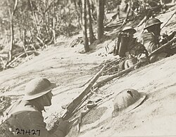
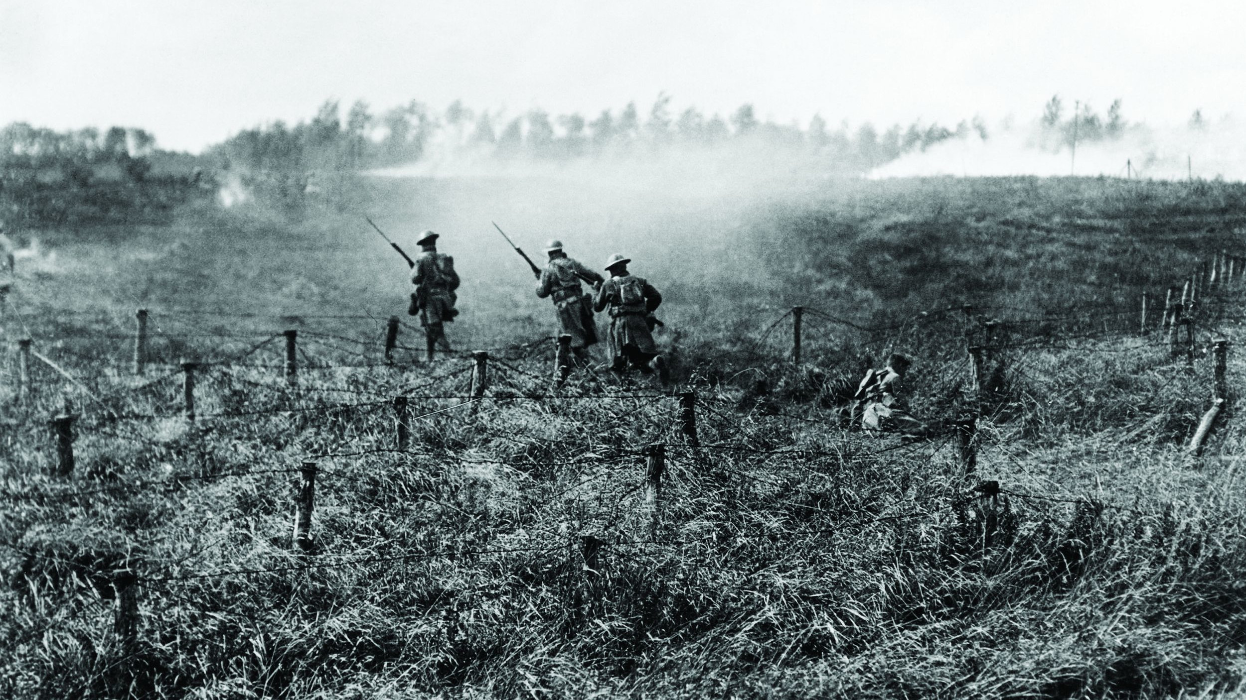
Initial Assault
Phase 1
The offensive began on 26 September 1918 with a massive Allied artillery barrage followed by a general infantry assault by the American First Army.
Initial results
AEF attempted rapid advance but was slowed by terrain, logistics, and coordination issues.
Heavy casualties from German machine guns and artillery.
Units outran supplies and artillery support.
Key Event: Command Reorganization
Pershing relieved ineffective commanders.
Transitioned operational control to improve corps-level coordination.

Slide 8
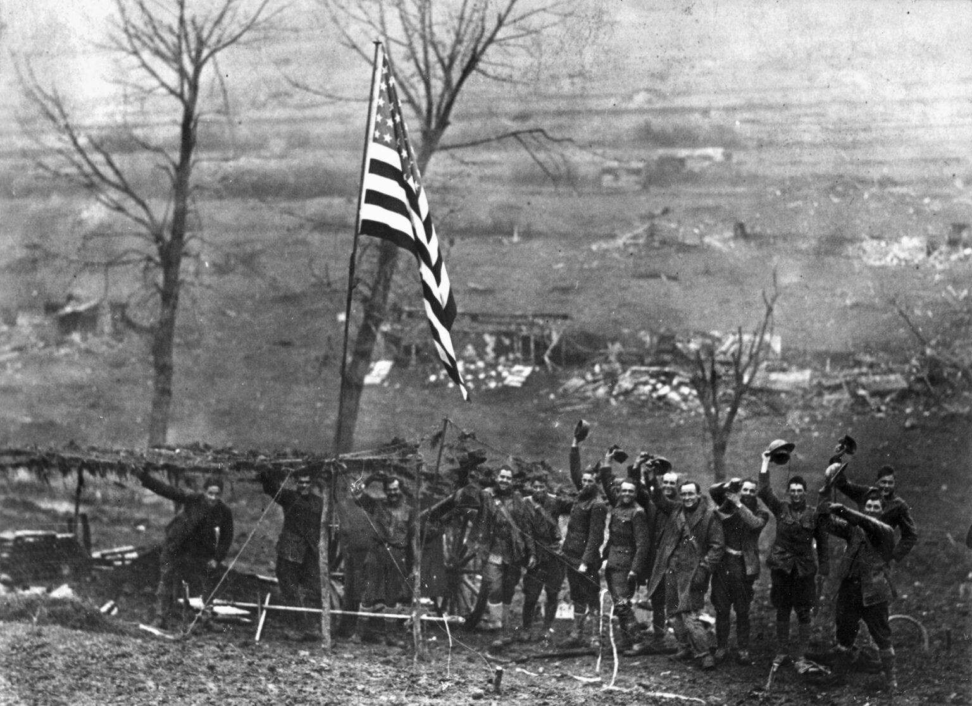
Adaptation and Breakthrough
Phase 2: Early October – Late October
Offensive resumed with better planning and artillery coordination.
Gradual advances through the Argonne and along the Meuse Heights.
The Lost Battalion (77th Division) surrounded but held position.
SGT Alvin York captured over 100 German soldiers during a patrol action.
German forces continued fighting delaying actions but were steadily pushed back.
Phase 3: Final Breakthrough (Late October – 11 November)
Improved logistics and fresh divisions increased combat effectiveness.
AEF captured key terrain and advanced toward Sedan.
German forces began collapsing under pressure across the Western Front.
Forced Germany into armistice.

Slide 9
Outcome
Military:
~122,000 U.S. Casualties, ~26,000 U.S. Killed, ~4,000 missing/captured
~120,000 German Casualties, ~28,000 Germans Killed, ~44,000 prisoners
German operational collapse
Breakthrough achieved
Political:
Germany seeks armistice
U.S. emerges as major power

Slide 10
Significance & Lessons
Principles Applied:
Offensive persistence
Mission Command (adaptation)
Combined arms integration
Lessons learned:
Logistics drives tempo
Combined arms synchronization is critical
Leadership adaptation determines success

